Slide 1

Credit Card Fraud Detection
Arpan Avvari

Slide 2
Data Explanation
PCA is a dimensionality reduction technique that transforms a large set of variables into a smaller one while retaining most of the information.
Features V1, V2, … V28 are the principal components obtained with PCA, the only features which have not been transformed with PCA are 'Time' and 'Amount'.
The feature 'Amount' is the transaction Amount
Feature 'Class' is the response variable and it takes value 1 in case of fraud and 0 otherwise.

Slide 3
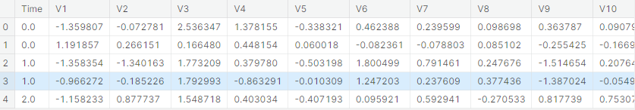
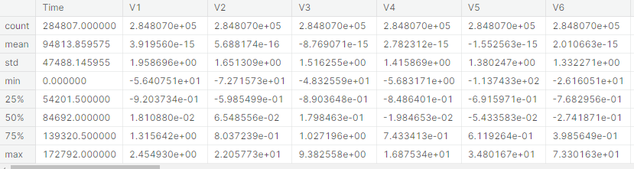
Data Sample

Slide 4
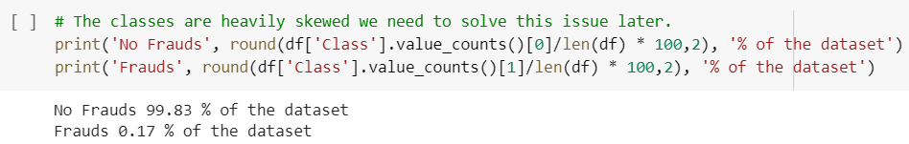
Problem Solving
In 2018, $24.26 billion was lost to payment card fraud worldwide.
Less than 0.2% transactions are Fraud, therefore it's hard to predict the fraudulent activity.
This dataset presents transactions that occurred in two days, where we have 492 frauds out of 284,807 transactions.
The dataset is highly unbalanced, the positive class (frauds) account for 0.172% of all transactions.
The dataset is highly unbalanced, the positive class (frauds) account for 0.172% of all transactions.

Slide 5
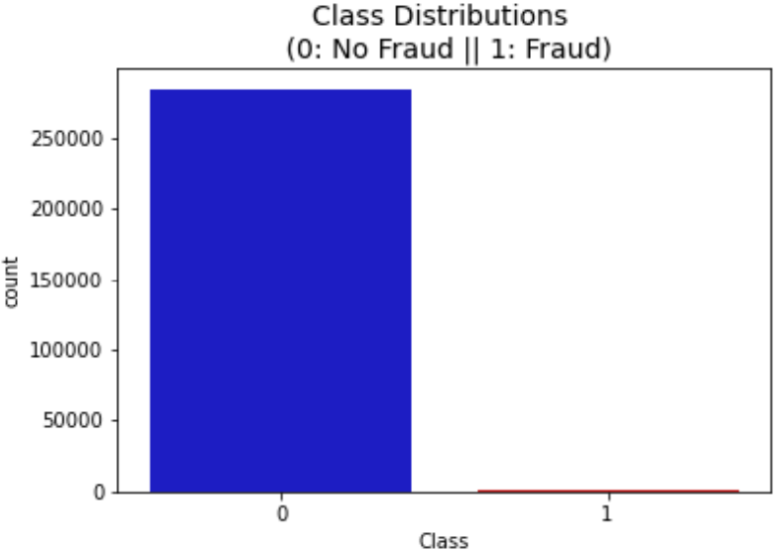
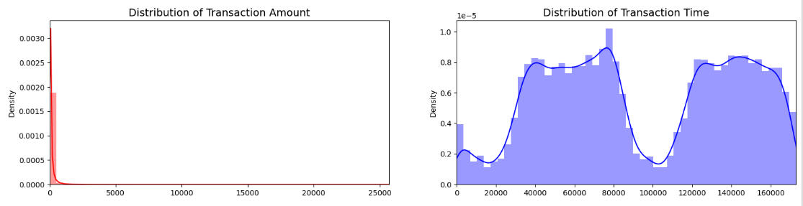
Plots for Dataset Analysis
Class Distribution plot: It shows the distribution of the target variable (class) in the dataset. In this case, the dataset is highly imbalanced, with a majority of non-fraudulent transactions and a very small percentage of fraudulent transactions.
The Distribution of Transaction Amount plot shows most transactions are of small amounts, and the Distribution of Transaction Time plot shows a peak of transactions occurring between 50000 and 100000.

Slide 6

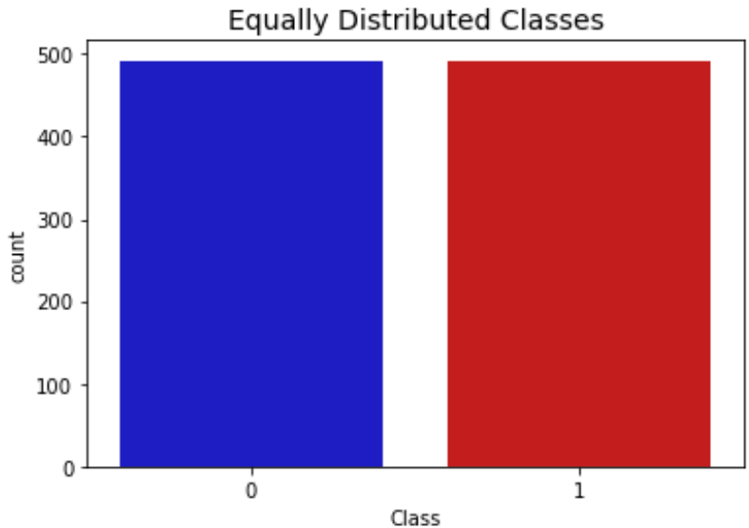
Plots for Dataset Analysis
Most of our data has already been scaled we should scale the columns that are left to scale such as Amount and Time
Equally Distributed Classes plot: It shows the distribution of the target variable (class) in a subsample dataset created by balancing the number of fraudulent and non-fraudulent transactions. This plot shows an equal distribution of both classes in the subsample dataset.

Slide 7
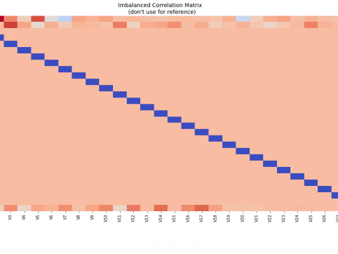
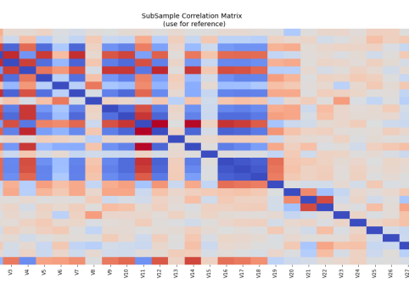
Correlation Matrix for Imbalance Data & Balanced Data
Imbalanced dataset can potentially hide important correlations between features and the target variable
Second heatmap, which shows the correlation between the features of a subsample of the data and the target variable, is a better reference because it provides a clearer indication of the relationship between the features and the target variable in the context of fraud detection

Slide 8
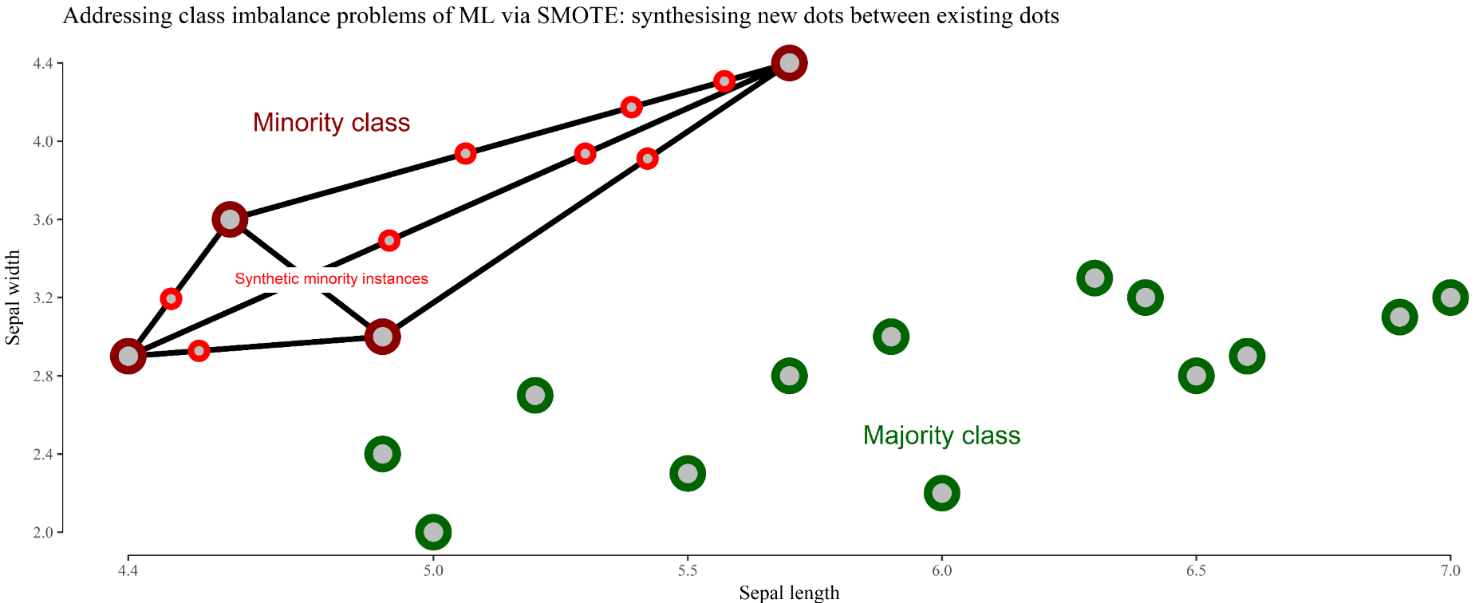
SMOTE Technique (Over-Sampling)
SMOTE stands for Synthetic Minority Over-sampling Technique. Unlike Random UnderSampling, SMOTE creates new synthetic points in order to have an equal balance of the classes. This is another alternative for solving the "class imbalance problems".
Understanding SMOTE:
Solving the Class Imbalance: SMOTE creates synthetic points from the minority class in order to reach an equal balance between the minority and majority class.
Location of the synthetic points: SMOTE picks the distance between the closest neighbors of the minority class, in between these distances it creates synthetic points.
Final Effect: More information is retained since we didn't have to delete any rows unlike in random undersampling.
Accuracy || Time Tradeoff: Although it is likely that SMOTE will be more accurate than random under-sampling, it will take more time to train since no rows are eliminated as previously stated.

Slide 9
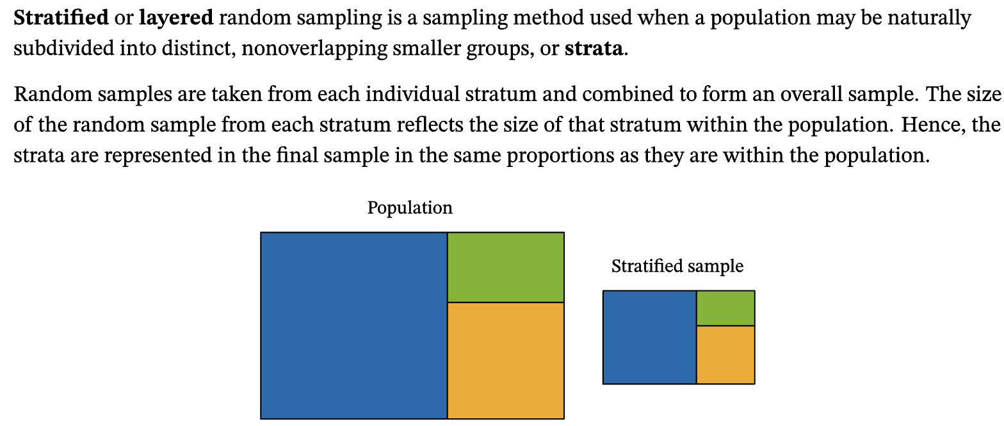
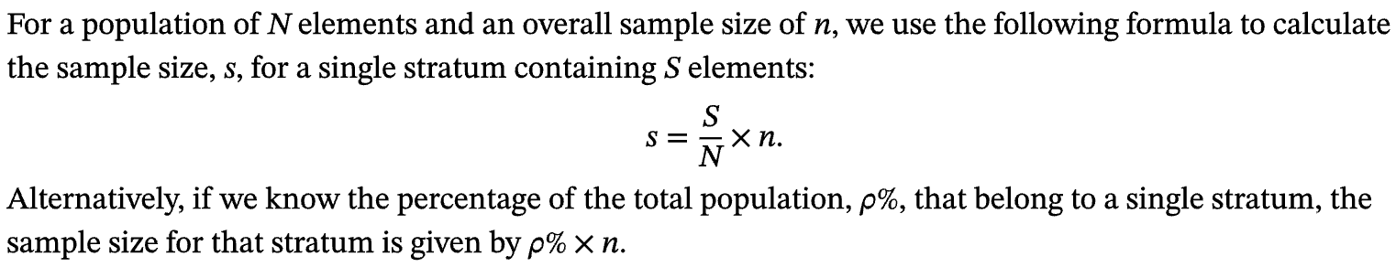
Stratified Sampling

Slide 10
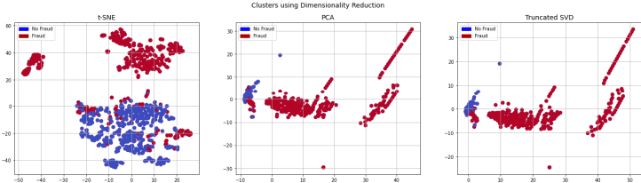
Clustering Data using Dimensionality Reduction :
t-SNE, PCA, and Truncated SVD
t-SNE algorithm can pretty accurately cluster the cases that were fraud and non-fraud in our dataset.
Although the subsample is pretty small, the t-SNE algorithm is able to detect clusters pretty accurately in every scenario.
This gives us an indication that further predictive models will perform pretty well in separating fraud cases from non-fraud cases.

Slide 11
ML Models Implemented & Parameters
Logistic regression estimates the probability of an event occurring, such as voted or didn't vote, based on a given dataset of independent variables.
The K-nearest neighbors (KNN) best estimator is the KNN model that achieves the highest cross-validation score during hyperparameter tuning.
Support Vector Classifier (SVC) is a supervised machine learning algorithm that tries to find the optimal hyperplane to separate different classes in the data.

Slide 12
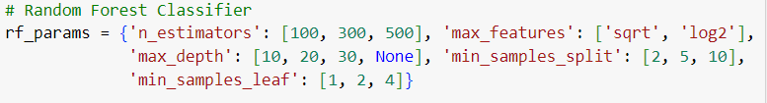
ML Models Implemented & Parameters
Decision Tree Classifier is a supervised machine learning algorithm that builds a tree-like model of decisions and their possible consequences in order to predict the class or value of a target variable.
Gradient Boosting Classifier (GBC) iteratively trains weak decision tree models to correct the errors made by previous models and improve the overall prediction accuracy.
Random Forest Classifier builds multiple decision trees and combines their predictions to improve the overall accuracy and reduce overfitting.

Slide 13
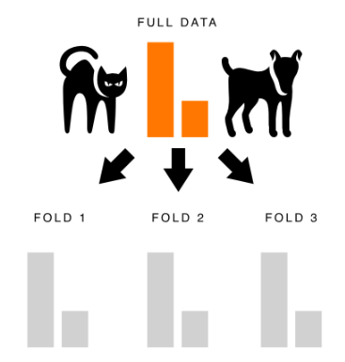
Stratified KFold Cross Validation
Stratified kfold cross validation is an extension of regular kfold cross validation but specifically for classification problems where rather than the splits being completely random, the ratio between the target classes is the same in each fold as it is in the full dataset.
Let’s look at an example. If we are building a model to classify images of cats and dogs and we have a data set that’s comprised of 75% cat images and 25% dog images, using stratified kfold cross validation will mean that each fold we create remains close to this 75/25 ratio.
When to Use Stratified Kfold Cross Validation
1. We want to preserve the class ratio of our target
2. We have relatively fewer training examples

Slide 14
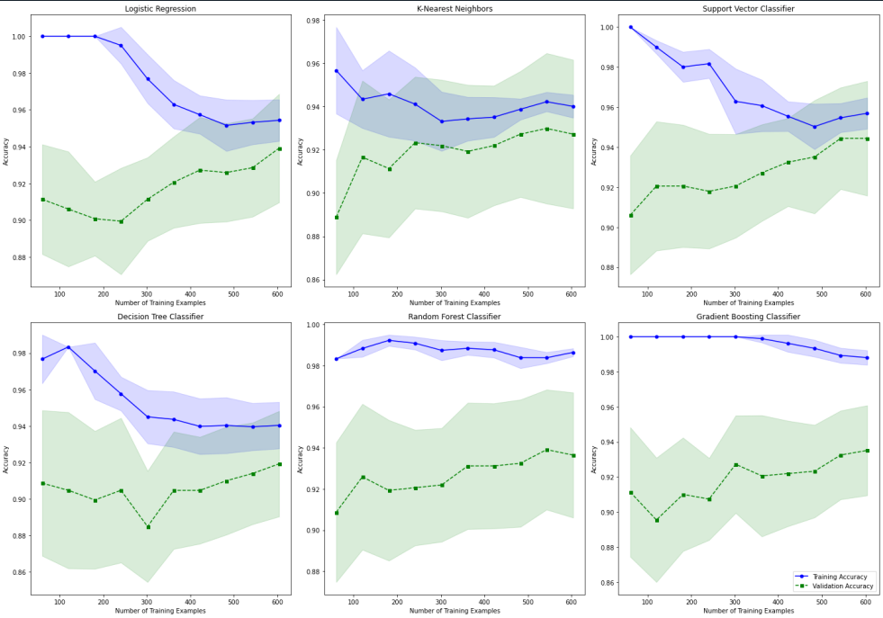
Learning curve for Multiple ML Models

Slide 15
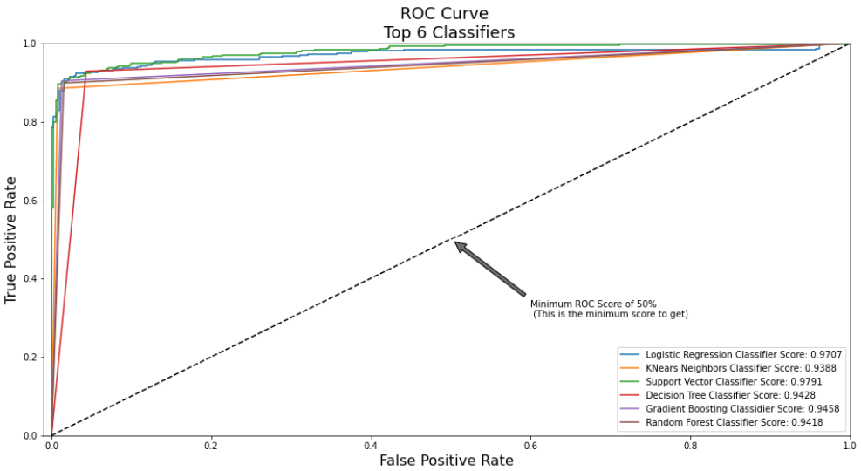
ROC Curve

Slide 16
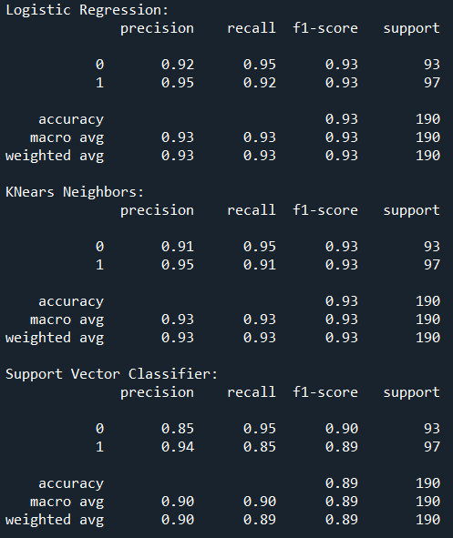
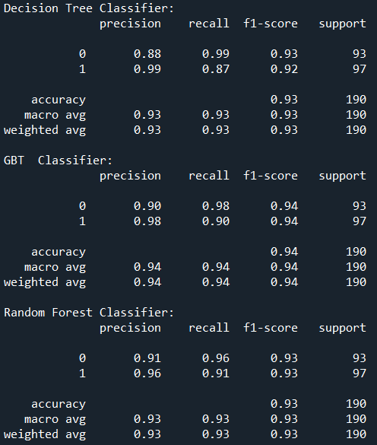
Classification Model Performance Comparison.

Slide 17
Thank You

